Slide 1

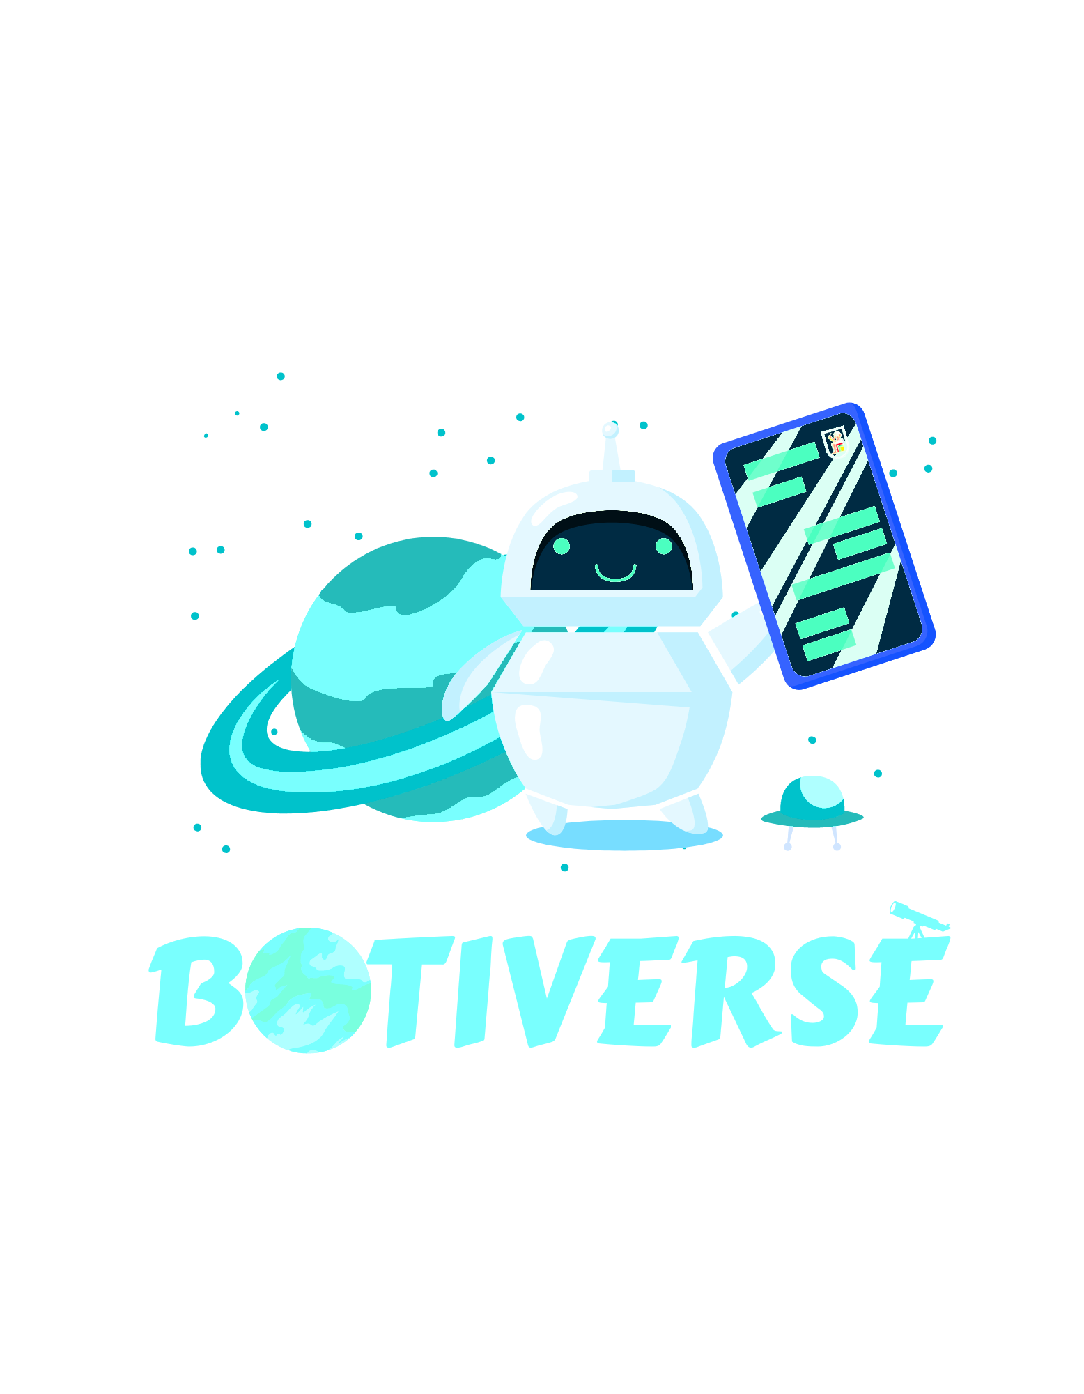

Faculty of Engineering
Cairo University
A Cosmos of Chatbots, One Import Away…
Notes:
Team 11
Guess what we are from the slogan!

Slide 2
TEAM MEMBERS
Essam Wisam
Karim Taha
Mohamed Saad
Yousef Atef
Supervised by Dr. Mona Farouk

Slide 3
TABLE OF CONTENTS
MOTIVATION
PROBLEM STATEMENT
RELATED WORK
PROPOSED SOLUTION
SYSTEM ARCHITECTURE
DEMO & RESULTS
CONCLUSIONS
FUTURE WORK
Notes:
Mainly two parts,
1 – What motivated us to make this our project
2 – Our system architecture, tools and challenges
Timeline of course

Slide 4
MOTIVATION
Chatbots are becoming an essential part of every business
Projected to save businesses 2.5B hours by 2023 [Juniper Search]
Offer infinite replication, availability and zero delay
Every start-up deserves easy access to chatbots
Notes:
2nd Bulletpoint => Hence
3rd Bulletpoint => In general

Slide 5
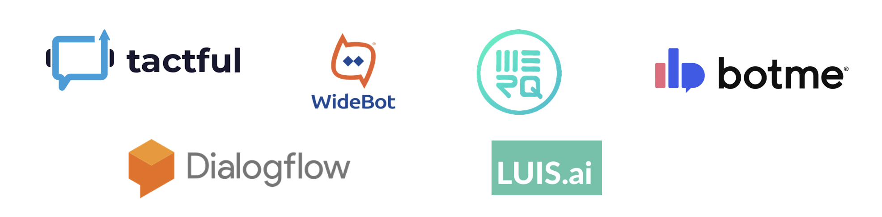
PROBLEM STATEMENT
There are two options for your company
Hire machine learning engineers
Seek paid services from chatbot companies that do
Notes:
2nd Bulletpoint => Hence
3rd Bulletpoint => In general

Slide 6
PROPOSED SOLUTION
Make a Chatbot Library Any Developer Can Use
Essentially
Modern
Truly
High-level
Vastly Diverse
Beyond Chatbots

Slide 7
PROPOSED SOLUTION
Essentially
Modern
Truly
High-level
Beyond Chatbots
Vastly Diverse

Slide 8

RELATED PRODUCTS
Botiverse is not the first chatbot library
One of the following must be true
H0: Current chatbot libraries offer all four features claimed by Botiverse
H1: Current chatbot libraries lack one or more of the four features
Search space is not huge

Slide 9
RELATED PRODUCTS
Chatterbot | Rasa | DeepPavlov
Most popular by a huge margin but no longer maintained
Doesn’t use deep learning
Uses deep learning
Built with backend developers in mind
Focuses on intent-based chat bots
Specialized for complex dialogue systems
Mainly Modernity Violations
Mainly Diversity & Modernity Violations
Mainly High-levelness Violations

Slide 10
TRULY HIGH-LEVEL?
Consider coding up the most “basic” function of our most “basic” chatbot
while True:
sentence = input("You: ")
if sentence == "quit": break
sentence = tokenize(sentence)
x = vectorize_sentence(sentence, all_words)
x = x.view(1, x.shape[0])
x = x.to(device)
output = model(x)
predicted = output.argmax(dim=1)
tag = classes[predicted.item()]
probs = torch.softmax(output, dim=1)
prob = probs[0][predicted.item()]
if prob.item() < 0.5: print(f"{bot_name}: Could you rephrase that?")
Essentially
Modern
Truly
High-level
Beyond Chatbots
Vastly Diverse

Slide 11
TRULY HIGH-LEVEL?
All you need is instead.
from botiverse.bots import basic_chatbot
bot = basic_chatbot(machine='svm', repr='tf-idf')
bot.train('dataset.json')
bot.save('basic_chatbot')
# Now this can run on the server
response = bot.infer("Which majors do the university offer?")
Essentially
Modern
Truly
High-level
Beyond Chatbots
All chatbots implemented follow this API (or very similar)

Slide 12


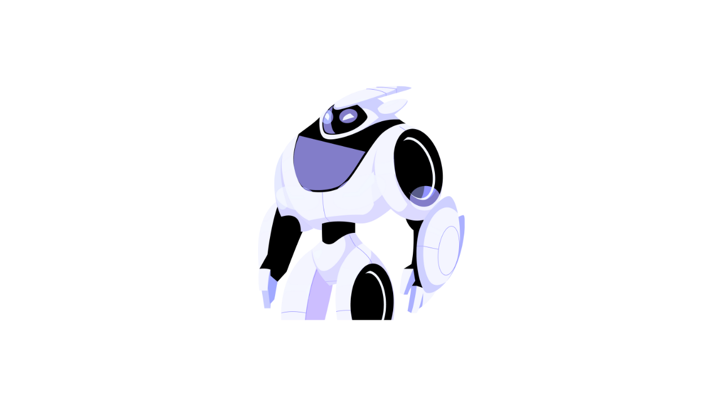


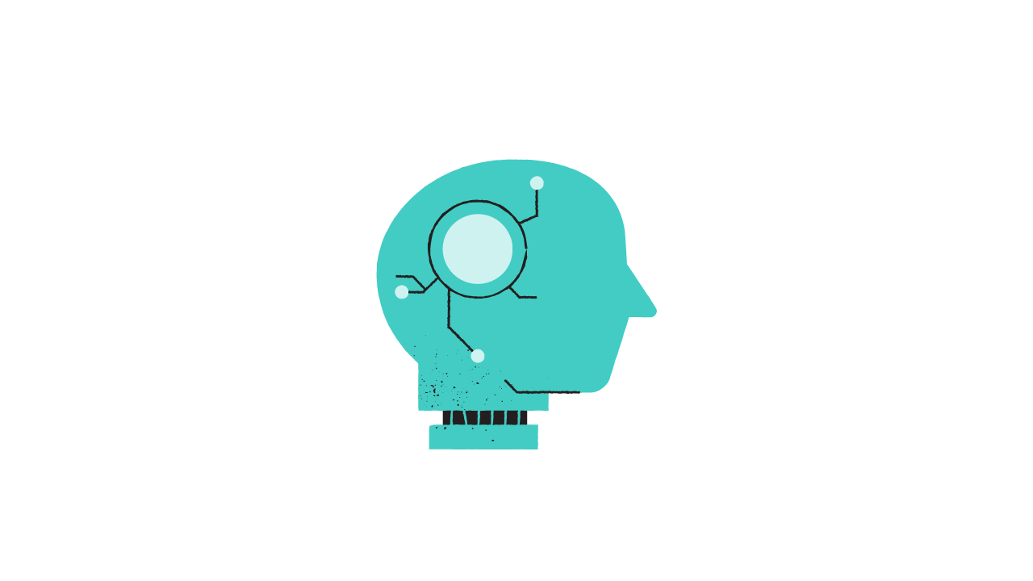
Vastly Diverse?
Supports 6 Different Chatbot Architectures for Different Use Cases
Essentially
Modern
Truly
High-level
Basic
Chatbot
Whiz Bot
Task
Bot
ConverseBot
Voice Bot
Theorizer
Extract QA Pairs
Data = Paragraph + QA
Intent-based
Data = QA Pairs (FAQs)
Task-oriented
Data = QA, State
Open-ended
Data = Convos
Intent-based
Data = Speech/FSM

Slide 13
Essentially Modern?
BoW
TF-IDF
GloVe
Custom
Byte Pair
BERT
MFCC
Wav2Vec
Special
Basic
Chatbot
Whiz Bot
Task
Bot
ConverseBot
Voice Bot
Theorizer
Neural Network
SVM
Custom
GRU
LSTM
BERT
GPT-2
T5
Fast
Speech
Siamese Net
white frame implies ready-made; else from scratch for some definition of that.

Slide 14
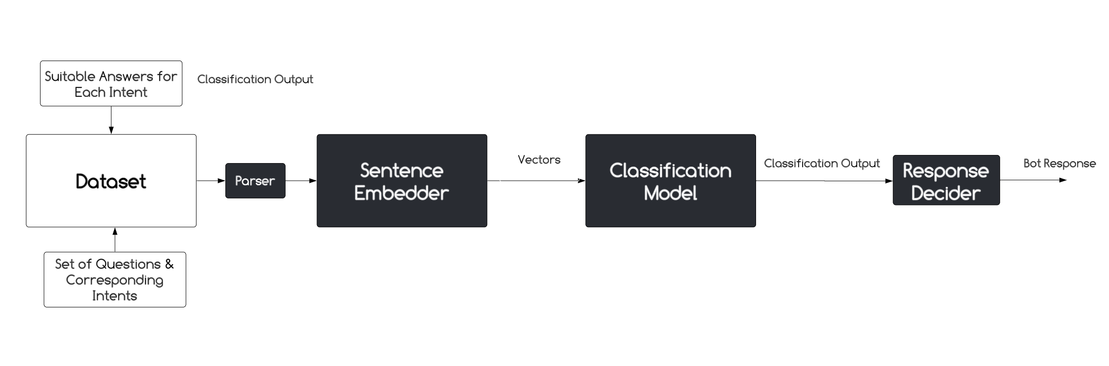
SYSTEM ARCHITECTURE
BoW
TF-IDF
TF-IDF-Glove
GloVe
Custom
Preprocessors
Basic
Chatbot
Neural Network
SVM
Custom
Models
Intent-based
Data = QA Pairs (FAQs)

Slide 15
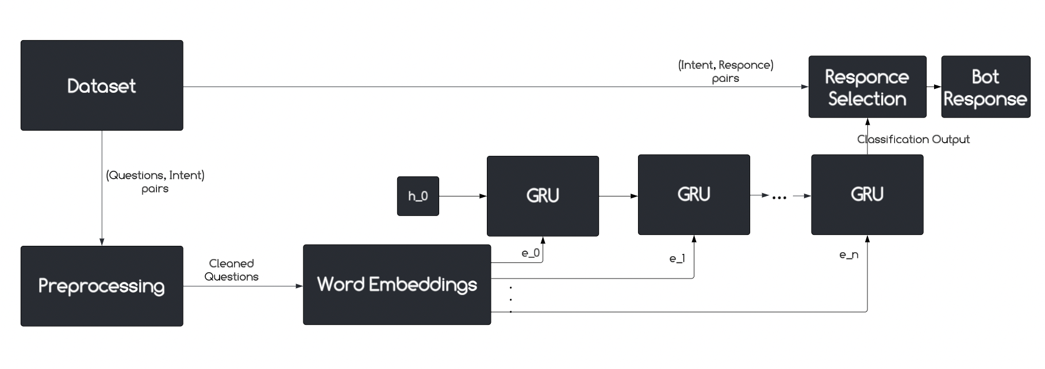
SYSTEM ARCHITECTURE
BERT
Byte-pair
Preprocessors
Whiz Bot
Neural Network
GRU
Models
Intent-based
Data = QA Pairs (FAQs)

Slide 16
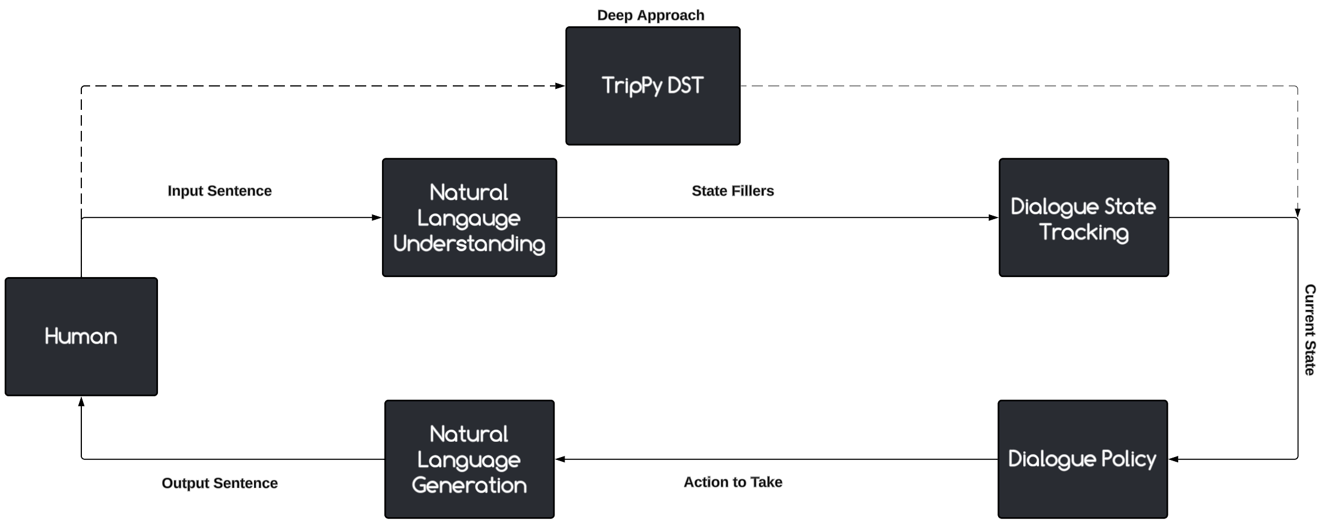
SYSTEM ARCHITECTURE
Special
Preprocessors
Task
Bot
Task-oriented
Data = QA, State
Rule-based
BERT
Models
[1] Paper: A Triple Copy Strategy for Value Independent Neural Dialog State Tracking by Heck et al.

Slide 17
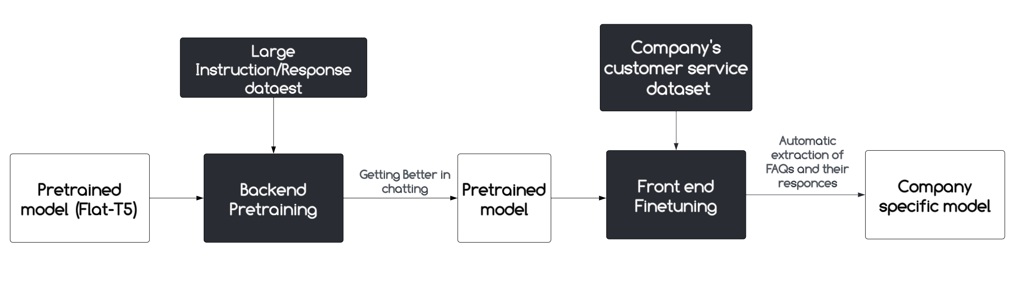
SYSTEM ARCHITECTURE
Special
Preprocessors
ConverseBot
T5
Open-ended
Data = Convos
Models
[2] Paper: Exploring the Limits of Transfer Learning with a Unified Text-to-Text Transformer by Raffel et al
[3] Paper: Scaling Instruction-Finetuned Language Models by Chung et al

Slide 18
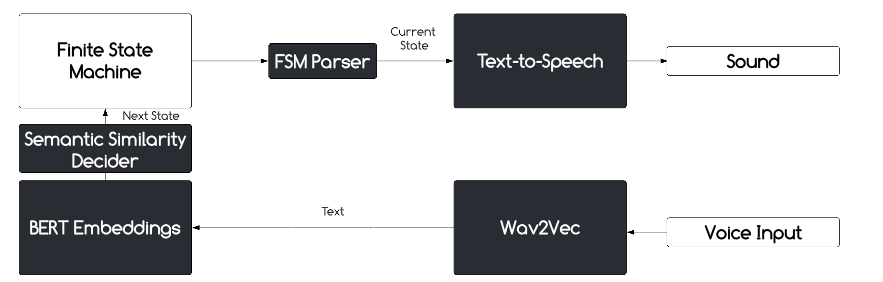
SYSTEM ARCHITECTURE
BERT
Preprocessors
Voice Bot
FastSpeech
Wav2Vec
Intent-based
Data = FSM
Models

Slide 19
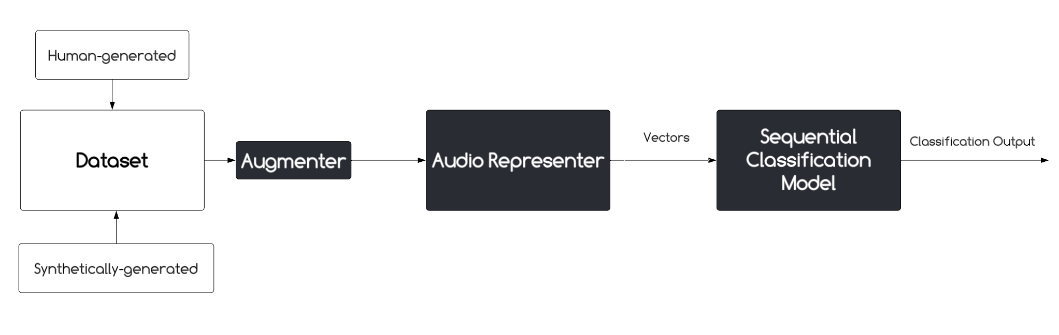
SYSTEM ARCHITECTURE
MFCC
Spectrogram
Wav2Vec
Preprocessors
Voice Bot
LSTM
Siamese
Intent-based
Data = Speech
Models
[4] Paper: EfficientWord-Net: An Open Source Hotword Detection Engine based on One-shot Learning

Slide 20
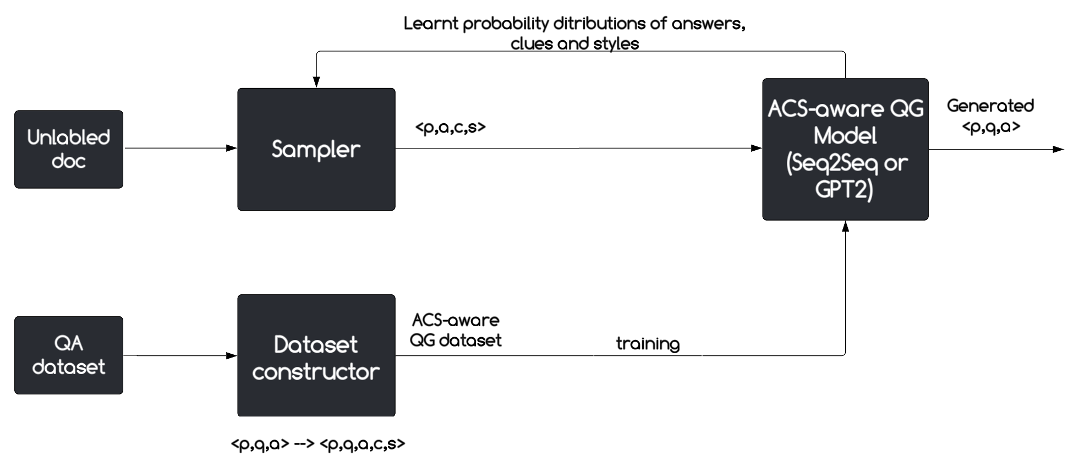
SYSTEM ARCHITECTURE
Special
Preprocessors
Theorizer
Extract QA Pairs
Data = Paragraph + QA
GPT-2
Models
[5] Paper: Asking Questions the Human Way: Scalable Question-Answer Generation from Text Corpus

Slide 21
DEMO & RESULTS
Basic
Chatbot
Code
from botiverse import chat_gui
from botiverse.models import NeuralNet
from botiverse.preprocessors import GloVe
from botiverse.bots import basic_chatbot
model = NeuralNet(structure=[50, 12, 8], activation='sigmoid')
transform = GloVe()
bot = basic_chatbot(machine=model, repr=transform)
bot.train('dataset.json', batch_size=1, epochs=30, λ=0.02, val_split=0.0)
# now this can run on the server
chat_gui = chat_gui(bot.infer)
chat_gui.run()

Slide 22
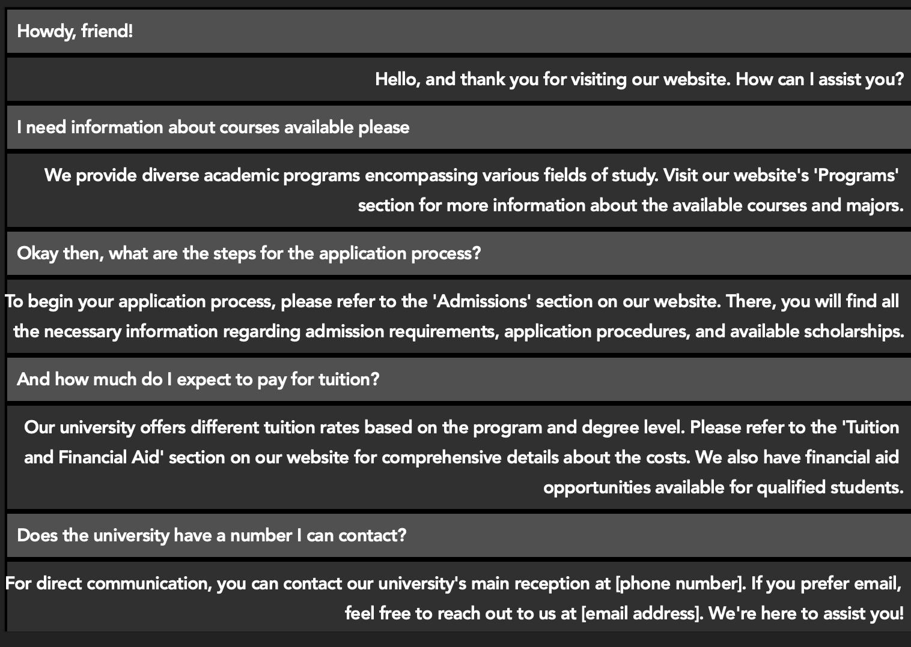
DEMO & RESULTS
Basic
Chatbot
Dataset
Demo
"tag": "admissions",
"patterns": [
"How can I apply to the university?",
"What are the admission requirements?",
"Tell me about the application process"
],
"responses": [
"To apply to our university, ...",
"To begin your app…]},
{
"tag": "tuition",
"patterns": [
"How much is the tuition fee?",
"What are the tuition costs?",
"Tell me about the financial aspects of attending the university"
],
"responses": [
"The tuition fees for...",
"Our university offers..."
]

Slide 23
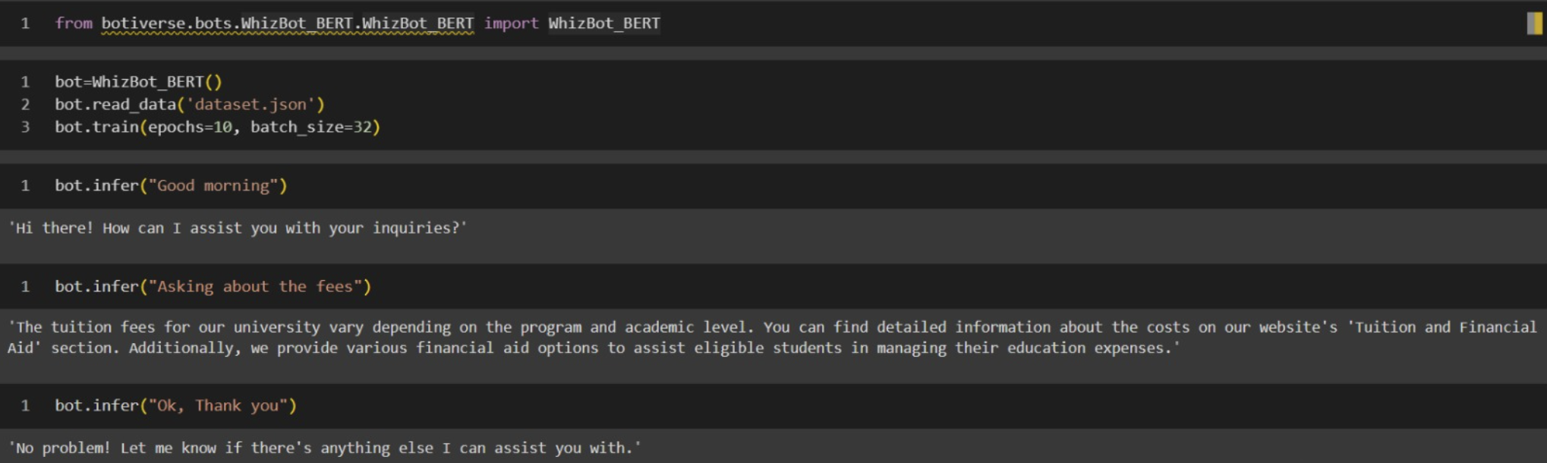
DEMO & RESULTS
Whiz
Bot
Demo

Slide 24
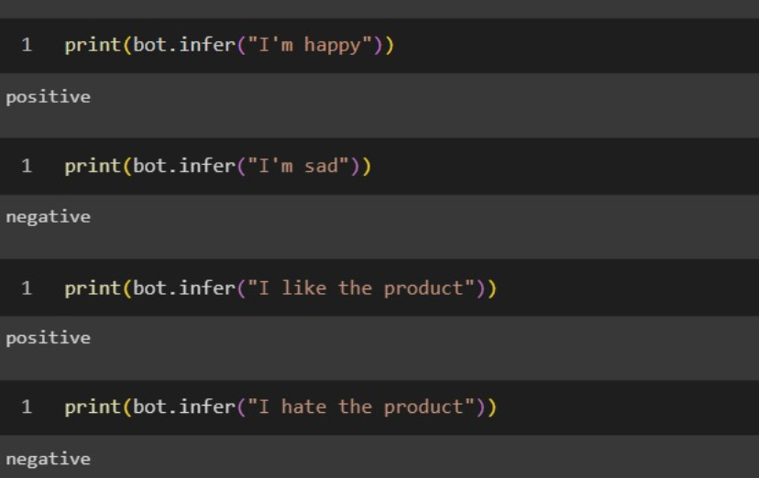
DEMO & RESULTS
Whiz
Bot
Demo

Slide 25
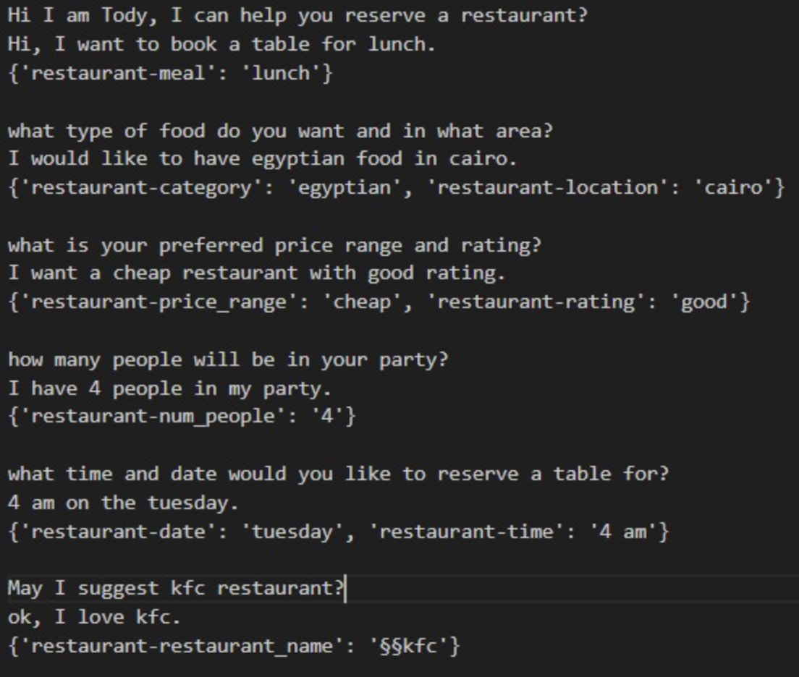
DEMO & RESULTS
Task
Bot
Demo

Slide 26
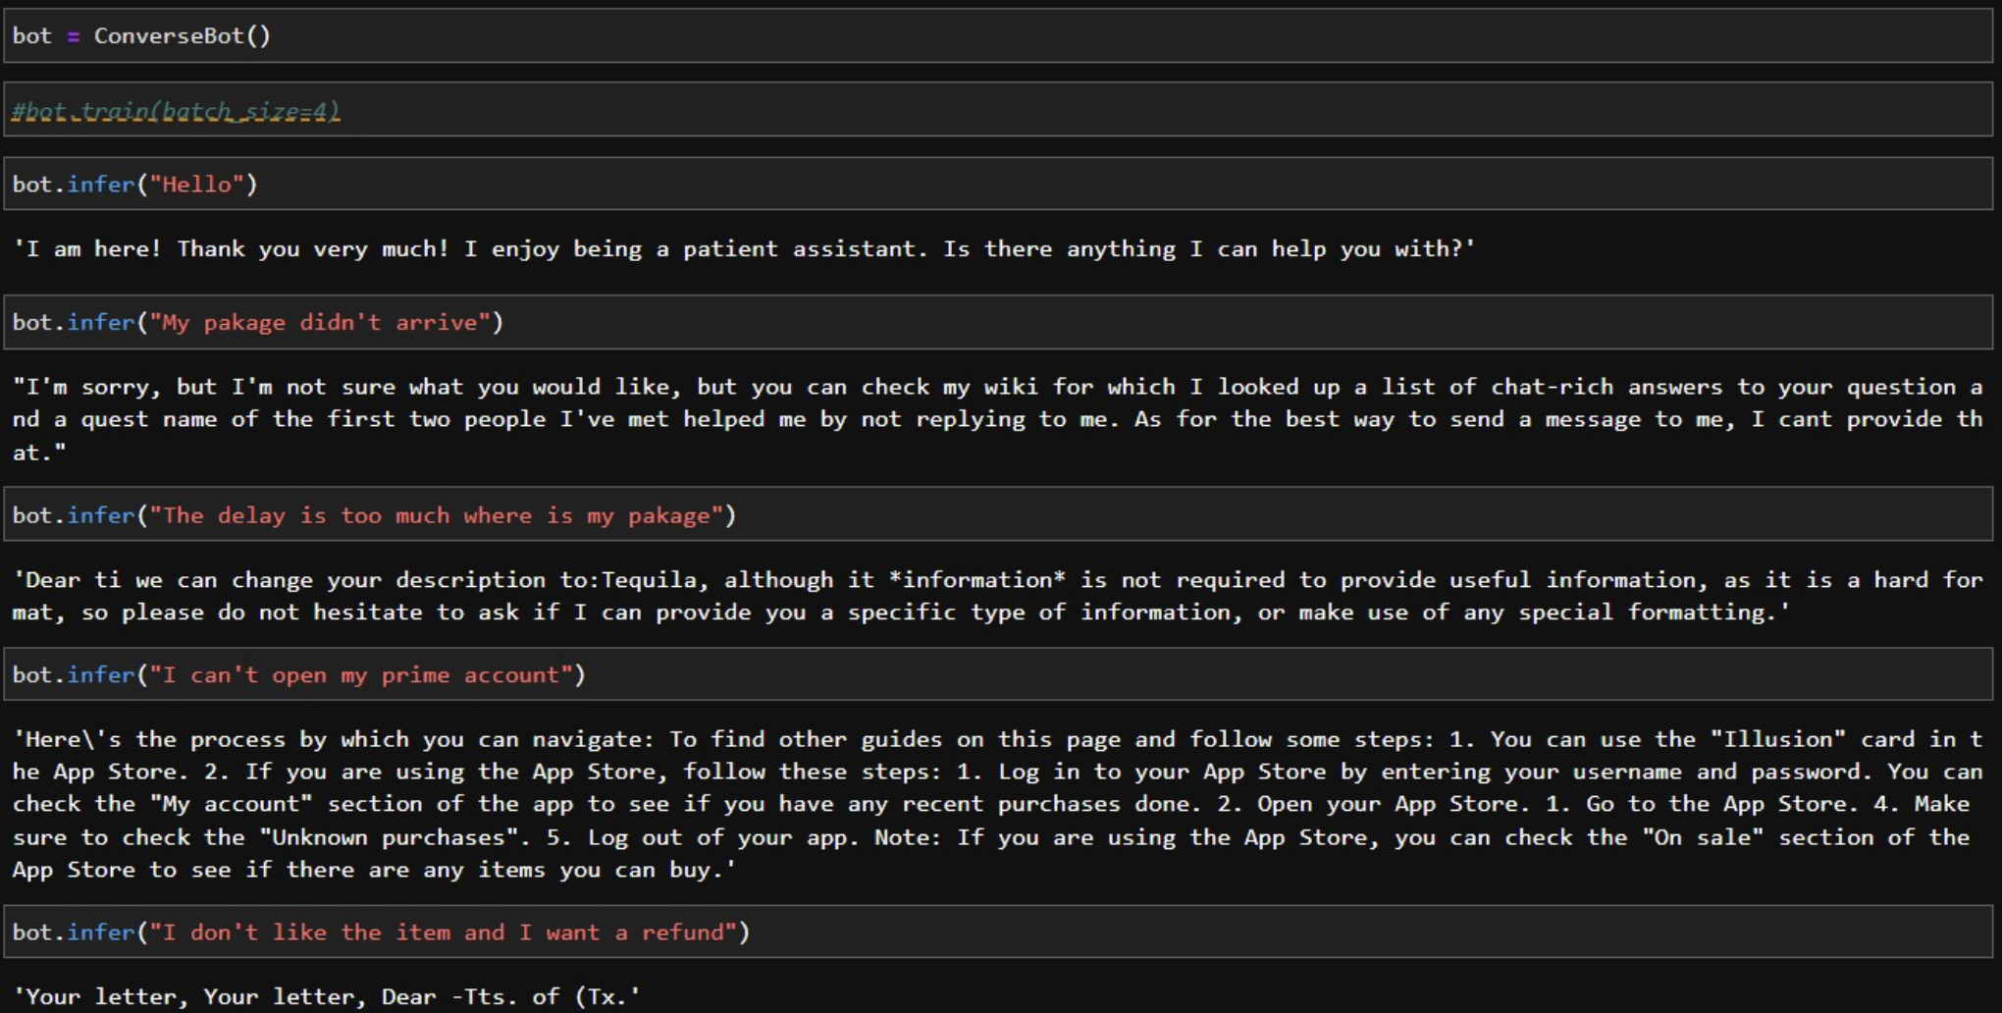
DEMO & RESULTS
Converse Bot
Demo (Before Pretraining)

Slide 27
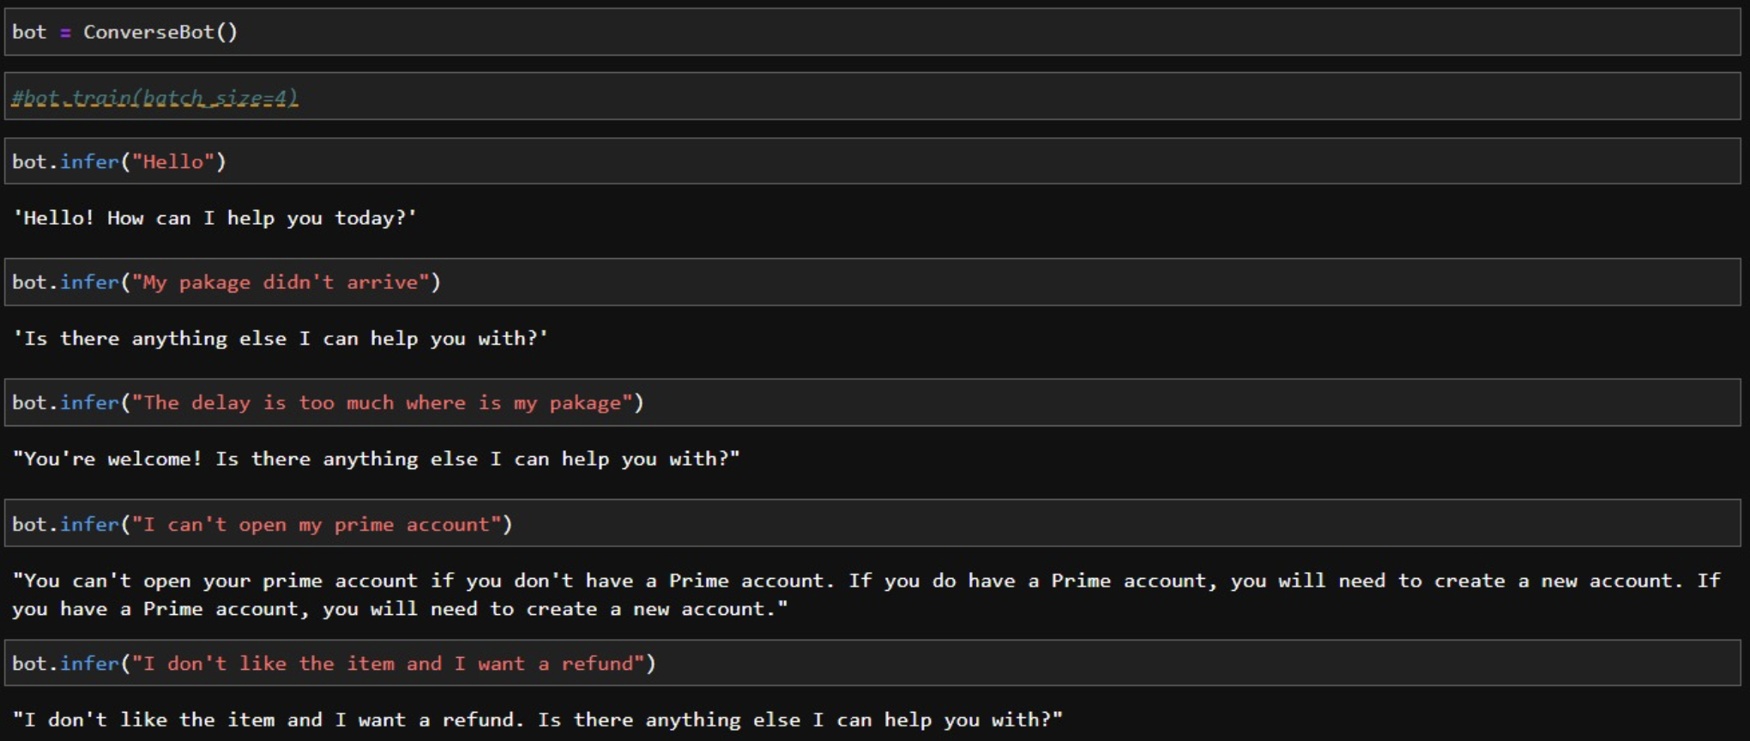
DEMO & RESULTS
Converse Bot
Demo (After Pretraining)

Slide 28
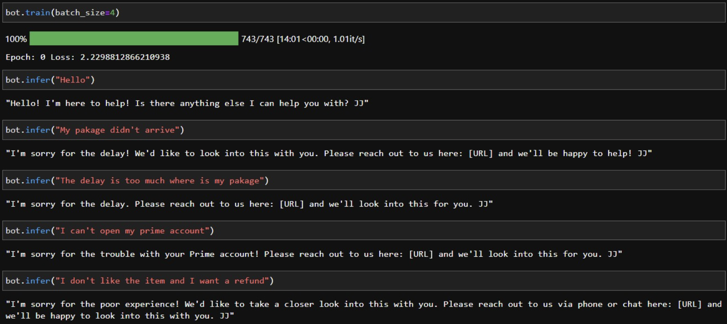
DEMO & RESULTS
Converse Bot
Demo (After Finetuning)

Slide 29
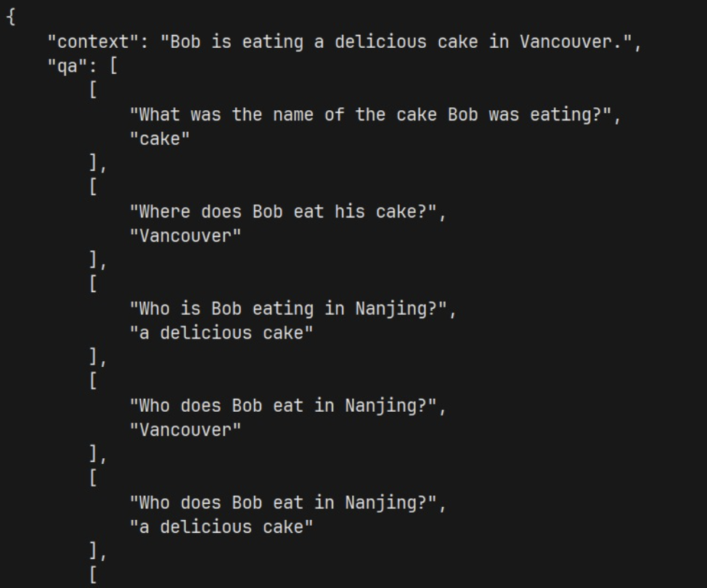
DEMO & RESULTS
Theorizer
Demo

Slide 30
DEMO & RESULTS
Voice
Bot
Code
from botiverse.bots import SpeechClassifier
from botiverse.bots.Vocalizer.utils import voice_input
S = SpeechClassifier(['Yes', 'No'], samplerate=16000, duration=0.9, repr='wav2vec')
X, y = S.generate_read_data(force_download_noise=False, n=5)
S.fit(X, y, hidden=128, patience=100, α=0.01)
audio_path = voice_input(record_time=3, voice_threshold=900)
S.predict(audio_path)
Results
Model | Dataset | Accuracy
Voice Bot (Binary Few Shot) | Kaggle Speech Command | 90%
Voice Bot | AudioMNIST | 93%
AlexNet | AudioMNIST | 95%
AudioNet | AudioMNIST | 93%

Slide 31

DEMO & RESULTS
Voice
Bot
Code
from botiverse.bots import Vocalizer
call = Vocalizer('call.json')
call.simulate_call()
Dataset
"B": {
"Bot": "Are you calling regarding an issue with your flight?",
"max_duration": "3",
"Options" : [
{
"Intent": "Yes",
"Speak": "Okay. We will try our best to get the issue resolved.",
"Next": "C"},
{
"Intent": "No",
"Speak": "Okay. Please call us back if you have any issues.",
"Next": "Z"} ]},

Slide 32
CONCLUSIONS
Chatbots are getting even more crucial for business every day
There is a lack of free and easy access to building chatbots
Such lack is now a matter of the past

Slide 33
FUTURE WORK
Automatic hyperparameter tuning for basic and whiz bots
Human-like responses with large language models for the task bot
Generalize with few shot settings using the voice bot
Botiverse may become a business

Slide 34
References
[1] Heck, M., van Niekerk, C., Lubis, N., Geishauser, C., Lin, H. C., Moresi, M., & Gasic, M. (2020). TripPy: A Triple Copy Strategy for Value Independent Neural Dialog State Tracking. In Proceedings of the 21th Annual Meeting of the Special Interest Group on Discourse and Dialogue (pp. 35-44). Association for Computational Linguistics. https://arxiv.org/abs/2005.02877
[2] Raffel, C., Shazeer, N., Roberts, A., Lee, K., Narang, S., Matena, M., Zhou, Y., Li, W., & Liu, P. J. (2020). Exploring the Limits of Transfer Learning with a Unified Text-to-Text Transformer. Journal of Machine Learning Research, 21(140), 1-67. https://arxiv.org/abs/1910.10683
[3] Chung, H. W., Hou, L., Longpre, S., Zoph, B., Tay, Y., Fedus, W., Li, Y., Wang, X., Dehghani, M., Brahma, S., Webson, A., Gu, S. S., Dai, Z., Suzgun, M., Chen, X., Chowdhery, A., Castro-Ros, A., Pellat, M., Robinson, K., Valter, D., Narang, S., Mishra, G., Yu, A., Zhao, V., Huang, Y., Dai, A., Yu, H., Petrov, S., Chi, E. H., Dean, J., Devlin, J., Roberts, A., Zhou, D., Le Q. V. & Wei J. (2022). Scaling Instruction-Finetuned Language Models. arXiv preprint arXiv:2210.11416. https://arxiv.org/abs/2210.11416
[4] R, C., Rangapur, A., & Sethuraman, S. C. (2021). EfficientWord-Net: An Open Source Hotword Detection Engine based on One-shot Learning. arXiv preprint arXiv:2111.00379. https://arxiv.org/abs/2111.00379
[5] Liu, B., Wei, H., Niu, D., Chen, H., & He, Y. (2020). Asking Questions the Human Way: Scalable Question-Answer Generation from Text Corpus. In Proceedings of The Web Conference 2020 (pp. 1213-1224). ACM. https://arxiv.org/abs/2002.00748

Slide 35
Project Modules
 | Essam (Basic, Voice Bot) | Mohamed (Whiz, Converse Bot) | Yousef (Deep/Classic Task Bot) | Karim (Theorizer) | Ready-made %
Neural Network, SVM, TF-IDF, BoW, TF-IDF-GloVe | 90% | 0% | 0% | 0% | 10%
LSTM, Siamese, FastSpeech | 80% | 0% | 0% | 0% | 20%
T5, GRU | 0% | 85% | 0% | 0% | 15%
BERT + Processing | 0% | 0% | 85% | 0 | 15%
GPT 2 + Processing | 0% | 0% | 0% | 50% | 50%

Slide 36
THANKS GOT QUESTIONS?

